Slide 1
DIGITAL PORTFOLIO
STUDENT NAME: S.Kumudhalakshmi
REGISTER NO:212400138
NMID: 2FFE4A0F2FDC94C8FC14F2E8C2D73425
DEPARTMENT: BCA
COLLEGE:SIVET college
UNIVERSITY: University of Madras

Slide 2
PROJECT TITLE
DIGITAL PORTFOLIO

Slide 3


AGENDA
Problem Statement
Project Overview
End Users
Tools and Technologies
Portfolio design and Layout
Features and Functionality
Results and Screenshots
Conclusion
Github Link
3/21/2024 Annual Review

Slide 4

PROBLEM STATEMENT
In today’s competitive environment, individuals often struggle to present their skills, achievements, and projects in an engaging and accessible way. A greeting digital portfolio solves this issue by providing an interactive platform that introduces the person, showcases their work, and creates a strong first impression for academic, professional, or personal growth opportunities.

Slide 5

PROJECT OVERVIEW
SUMMARY OF MY PORJECT:
This digital portfolio is designed to showcase my personal details, skills, and achievements in a simple and creative way. It serves as a platform to introduce myself and highlight my professional journey. The portfolio reflects my interests, strengths, and the projects I have worked on. It is created to make a strong impression and provide an easy way to connect with me.
MY PORTFOLIO CONTAINS:
about me
project
skill
contact

Slide 6

WHO ARE THE END USERS?
End Users of a Digital Portfolio:
Students / Fresher's: Teachers, examiners, recruiters (for internships or jobs), and peers (for collaboration).
Professionals: Employers, recruiters, clients, and networking contacts.
Freelancers: Potential clients, freelance platforms, and existing/new customers.
Creative Fields (Designers / Developers / Artists): Companies seeking collaborators, clients, and general audience.

Slide 7

TOOLS AND TECHNIQUES
Tools Used:
HTML – to structure the content of the portfolio.
CSS – to design and style the pages (colors, layouts, animations).
JavaScript – to add interactivity and dynamic features.
Code editor- virtual studio code

Slide 8
PORTFOLIO DESIGN AND LAYOUT
The portfolio is divided into clear sections: Home, About, Skills, Projects, Certificates, and Contact.
A clean and simple layout is used for easy readability.
Responsive design makes it accessible on desktop, tablet, and mobile devices.
Color combinations, fonts, and spacing are chosen to give a modern and professional look.
A navigation menu allows smooth movement between sections.
Animations and transitions are added to make the portfolio interactive and engaging.
8

Slide 9
FEATURES AND FUNCTIONALITY
Provides an interactive Home page with a greeting/introduction.
Includes sections like About, Skills, Projects, Certificates, and Contact for better organization.
Responsive design ensures it works on desktop, tablet, and mobile devices.
Navigation menu allows smooth movement between different sections.
Animations and transitions enhance the user experience.
Contact form or details make it easy for others to connect.

Slide 10
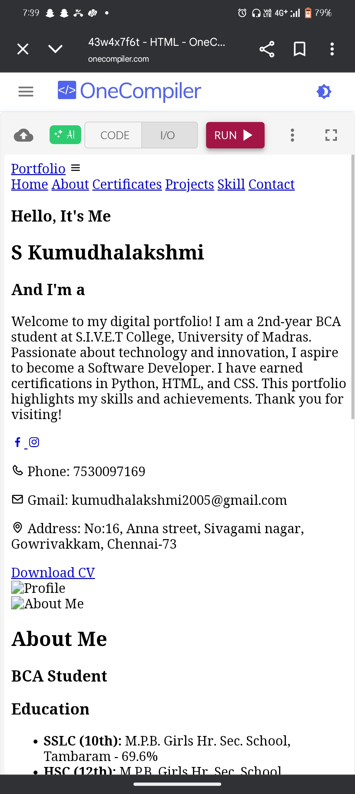

RESULTS AND SCREENSHOTS
BEFORE CSS:
3/21/2024 Annual Review
10

Slide 11
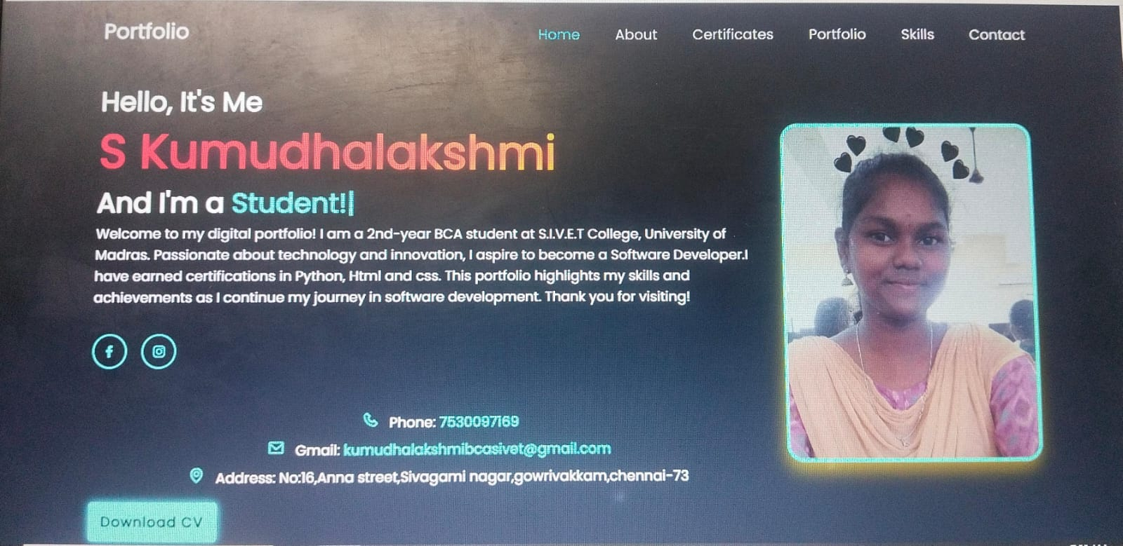
AFTER CSS :

Slide 12
CONCLUSION
Thank you for visiting my portfolio! I am passionate about learning, growing, and taking on new challenges. This portfolio reflects my skills, creativity, and dedication to building a strong foundation in my career. I look forward to exploring opportunities where I can contribute, collaborate, and continue to improve.
If you’d like to connect or know more about me, feel free to reach out through the contact section.
12

